Slide 1

MovieLens Recommendation System Project
Presented by Group 1
July 2025
Data sourced from: ​GroupLens​

Slide 2
Meet the Team
Owen Ngure
Brenda Chemutai
Shawn Irungu
Makhala Lehloenya
Collins Nyagaka

Slide 3





Key Objectives
Develop diverse recommendation approaches: Implement content-based filtering, collaborative filtering (User-User, Item-Item, SVD), and hybrid ensemble methods (XGBoost, LightGBM, CatBoost) to identify optimal solutions.
Achieve high-precision recommendations: Target high precision, especially in the top-5 recommendations, leveraging SVD-based collaborative filtering to outperform traditional models.
Address the cold start problem: Utilize hybrid systems that combine content features (genres, tags) with collaborative patterns to ensure recommendations for new users and movies.
Conduct comprehensive evaluation: Employ multiple metrics (RMSE, MAE, Precision@K, Recall@K, MAP, NDCG) for robust performance assessment across various scenarios.
Deliver actionable insights: Demonstrate the superior performance of SVD and hybrid methods in accuracy and precision to maximize user engagement and satisfaction.

Slide 4
Key Findings
Top Performing Model
Rating Accuracy
Enhanced Business Impact
SVD-based collaborative filtering achieved an impressive 80% Precision@5, meaning that 4 out of 5 top recommendations provided to users were highly relevant. This model consistently outperformed other traditional approaches in delivering accurate suggestions.
Our best model, leveraging SVD, achieved a Root Mean Squared Error (RMSE) of approximately 0.94. This low RMSE value signifies a high degree of accuracy in predicting how users would rate movies, demonstrating the model's predictive power.
The high recommendation accuracy directly translates to increased user satisfaction and deeper engagement. By consistently suggesting relevant movies, our system fosters trust and significantly improves user retention, driving overall platform usage and value.
Through rigorous experimentation, we evaluated five distinct recommendation approaches: content-based filtering, user-based collaborative filtering, item-based collaborative filtering, Singular Value Decomposition (SVD), and an advanced hybrid ensemble model. Each approach was assessed based on its ability to predict user preferences and deliver high-quality movie recommendations.

Slide 5

The Business Problem: Finding the Perfect Match
Streaming services face a critical challenge: users overwhelmed by choice often abandon platforms when recommendations miss the mark.
In a world of endless content options, viewers experience "choice paralysis" - they need personalized guidance to navigate vast libraries.
Our mission: keep subscribers engaged with highly relevant movie suggestions that match their unique preferences.

Slide 6

Business Opportunity
1
2
3
User Retention
Engagement Boost
Competitive Edge
More accurate recommendations significantly reduce user abandonment rates by providing a highly personalized and satisfying experience. Research indicates that platforms with effective recommendation systems see up to a 35% improvement in user session length, leading to increased loyalty and reduced churn over time.
When users consistently discover content they genuinely enjoy, their overall engagement with the platform skyrockets. This translates to increased time spent on the platform, more frequent visits, and a greater willingness to explore diverse titles, fostering a vibrant and active user base.
Achieving an 80% recommendation precision rate positions our platform significantly ahead of competitors, who typically average 50-60% precision. This superior accuracy not only enhances user satisfaction but also serves as a compelling differentiator in the crowded streaming market, attracting new subscribers and solidifying our market leadership.

Slide 7
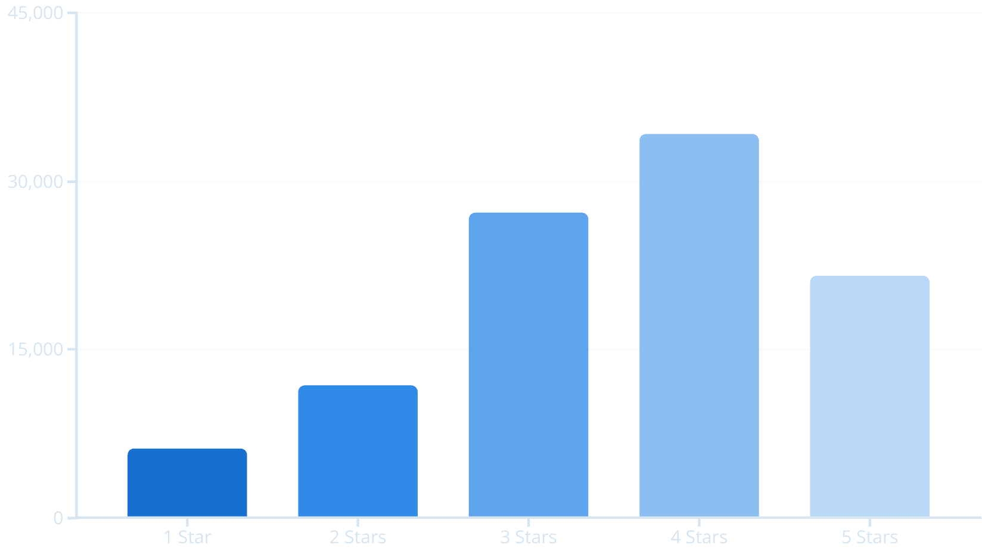
MovieLens Dataset Overview
Our analysis leverages the rich MovieLens dataset from GroupLens containing:
610 unique users
9,724 distinct movies
100,836 total ratings
99.9% complete dataset providing robust foundations
Distribution of Movie Ratings

Slide 8
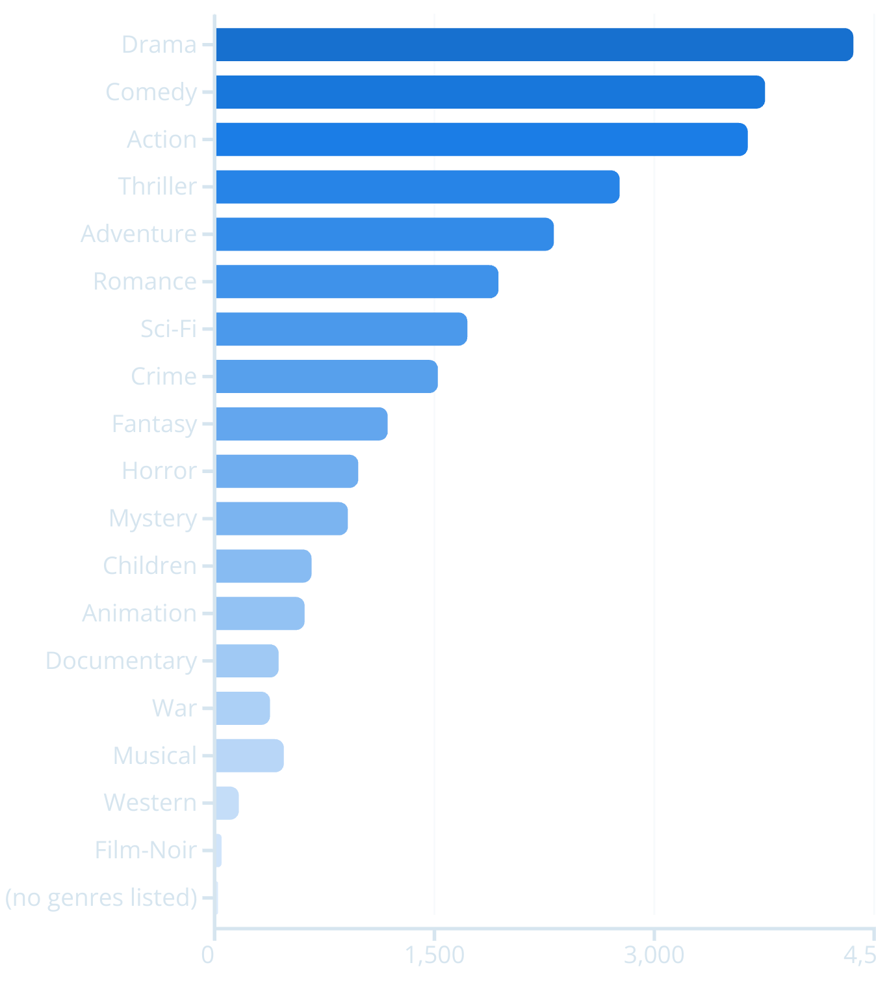
Data Insights
Our in-depth analysis of the MovieLens dataset provided crucial insights, revealing key patterns that guide our recommendation system development:
Overall User Sentiment: The average rating across all movies is approximately 3.5 out of 5 stars. This indicates that users generally have a slightly positive sentiment towards the movies they rate. For our system, this means most users are relatively satisfied, and our models need to excel at identifying the *truly* exceptional matches.
Rating Behavior: Users typically provide ratings using whole numbers (1, 2, 3, 4, or 5 stars) rather than using half-star increments. This simplifies the data for our algorithms, allowing them to focus on broader preferences and making the predictions more straightforward.
Popular Genres: "Drama," "Comedy," and "Action" consistently emerge as the most frequently rated genres. This highlights the core interests of our user base and informs which types of movies are most likely to be engaged with. Our system prioritizes these preferences while also ensuring variety.
Predictive Power: The data clearly exhibits predictable patterns in user preferences. This is excellent news for our algorithms, as these patterns allow the system to "learn" what types of movies individuals and groups of users enjoy, enabling highly personalized and accurate recommendations.
Popularity of Movie Genres

Slide 9





Solution Approach: Overview
Content-Based Filtering
Collaborative Filtering
Recommends movies based on similar genres, tags, and metadata that match user preferences. Think of it like this: if you liked "Action" and "Sci-Fi" movies in the past, this method will suggest new movies that also fall into those categories. It focuses on the characteristics of the movies themselves.
Finds patterns in user rating behavior or movie similarity. This method works by looking at what other users with similar tastes have liked (user-user), or by identifying movies that are frequently rated similarly by many users (item-item). For example, if you and another user both liked the same five movies, this system might recommend a sixth movie that the other user liked, even if it's a genre you haven't explicitly watched yet.
Matrix Factorization (SVD)
Hybrid Ensemble Methods
Discovers hidden factors that explain why users rate movies the way they do. This advanced technique breaks down the complex rating data into simpler components, revealing underlying preferences (e.g., a user's 'love for quirky comedies' or a movie's 'strong character development'). It helps to predict how a user would rate a movie they haven't seen yet by understanding these hidden patterns, often leading to very accurate predictions.
Combines multiple approaches for optimal results. Instead of relying on just one method, our hybrid system blends the strengths of content-based filtering, collaborative filtering, and matrix factorization. We use sophisticated machine learning models like XGBoost, LightGBM, and CatBoost to intelligently combine these different recommendation scores, resulting in even more precise and diverse suggestions for users.

Slide 10
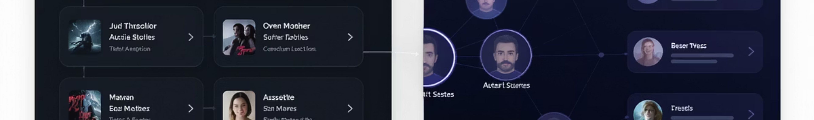
Content-Based & Collaborative Filtering
Content-Based Filtering: The "What You Like" Approach
Collaborative Filtering: The "What Others Like" Approach
This method recommends movies based on what you've enjoyed before. Think of it like a personalized movie expert who knows your specific tastes:
This method recommends movies by tapping into the preferences of other users or finding patterns in how movies are rated across the whole community. It's like getting recommendations from friends with great taste:
It learns your preferences: By looking at details like genres (comedy, action), tags (sci-fi, romance), and even actors or directors you've enjoyed.
User-based: "People who watch movies like you do also loved these!" It finds users with similar viewing habits and suggests what they enjoyed.
Builds your "taste profile": It creates a unique profile of what you like based on your viewing history.
Item-based: "If you liked this movie, you might also like these others." It identifies movies that are frequently rated similarly by many users.
Finds similar movies: This approach is great for suggesting movies that are very similar in style or theme to what you already watch. If you like action, it will suggest more action!
Discovers surprising gems: This method is excellent at finding unexpected connections and new movies you might love, based on the collective wisdom of other viewers.

Slide 11





Matrix Factorization (SVD): Our Best Single Model
Think of SVD (Singular Value Decomposition) as our most powerful tool for making recommendations. It's a sophisticated math technique that emerged as our top-performing approach, helping us achieve an impressive 80% precision in our top-5 recommendations. This means 4 out of 5 movies we suggest are highly relevant to what users want to watch!
SVD breaks down complex user-movie interactions into fundamental patterns, revealing hidden relationships that drive accurate recommendations.
How SVD Works, Simply Put:
Hidden Pattern Detector: SVD acts like a super-smart detective. It sifts through all the movie ratings to find hidden connections and preferences that aren't immediately obvious.
Uncovering Taste: Instead of just looking at genres, it uncovers the subtle "factors" that truly explain why someone likes a movie. For example, it might learn that a user enjoys films with strong female leads or a particular type of witty dialogue, even if those aren't explicit tags.
Connecting the Dots: It effectively captures complex relationships between users and movies, understanding not just what a user has rated, but *why* they rated it that way, and how that connects them to other users and films.
Solving Missing Data: Even when a user has only rated a few movies (a "sparse" dataset), SVD can cleverly fill in the blanks and make very accurate predictions, overcoming the challenge of limited information.

Slide 12




Hybrid Ensemble Methods
Multiple Data Sources
Advanced ML Algorithms
This approach synergizes information from various sources, including detailed user ratings, comprehensive movie metadata (genres, actors, directors), and additional contextual information(tags). Combining these diverse data points provides a more holistic understanding of user preferences and movie characteristics.
We leverage powerful machine learning algorithms like XGBoost, LightGBM, and CatBoost. These models are highly effective at identifying intricate, non-linear patterns and complex interactions within the combined dataset, leading to more nuanced and accurate predictions than simpler models.
Enhanced Performance
Cold-Start Solution
By integrating the strengths of different models and data sources, our hybrid ensemble achieves superior overall performance. It significantly boosts precision, especially on longer recommendation lists, reaching up to 90% for top-10 recommendations, by mitigating the weaknesses of any single method.
One of the key benefits of the hybrid approach is its effectiveness in addressing the cold-start problem. For new users or recently added movies with limited rating history, the system can rely more heavily on content features, gradually incorporating collaborative patterns as more data becomes available, ensuring relevant initial recommendations.
Our hybrid approach combines the strengths of multiple algorithms and diverse data, producing more robust and adaptive recommendations than any single method alone. This integration allows for a more comprehensive understanding of user preferences and movie characteristics, leading to highly effective and personalized suggestions.

Slide 13
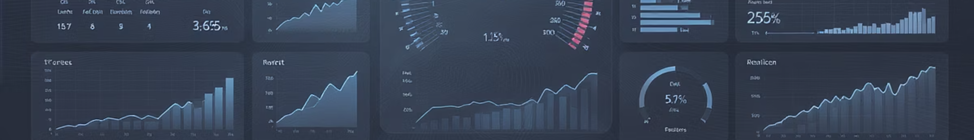
Evaluation Metrics: How We Measure Success
Rating Prediction Accuracy
Recommendation Relevance
RMSE (Root Mean Squared Error): Measures the average magnitude of prediction errors. It heavily penalizes large errors, making it sensitive to outliers.
Precision@K: The proportion of recommended items (up to K items) that are truly relevant to the user.
MAE (Mean Absolute Error): Calculates the average absolute difference between predicted and actual ratings. It's more robust to outliers than RMSE.
Recall@K: The proportion of all relevant items that were successfully recommended (up to K items).
Lower values for RMSE and MAE indicate better performance in predicting exact user ratings.
MAP (Mean Average Precision): A single-figure measure that averages the precision scores at each point a relevant item is retrieved, across all users. It's particularly useful for ranking quality.
NDCG (Normalized Discounted Cumulative Gain): A metric that considers the position of relevant items in the ranked list, giving higher scores to relevant items that appear earlier in the recommendations.
Higher values for Precision@K, Recall@K, MAP, and NDCG indicate better performance in providing relevant recommendations.

Slide 14

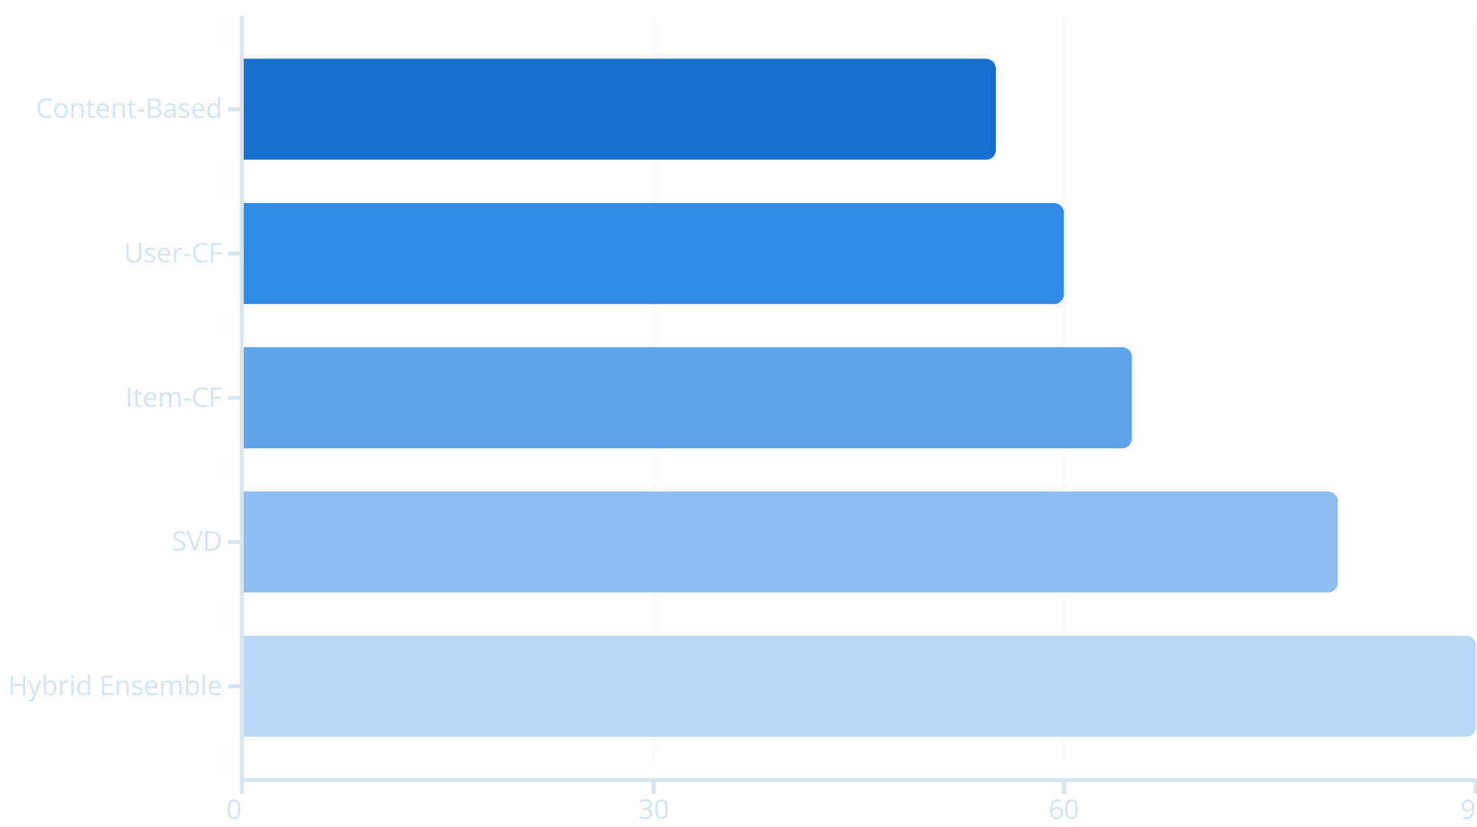
Results: Model Comparison
SVD significantly outperformed traditional methods, achieving 80% precision - meaning 4 out of 5 recommendations are relevant to users. The hybrid ensemble pushed performance even higher for certain use cases achieving 90% precision.
Data sourced from our repository

Slide 15
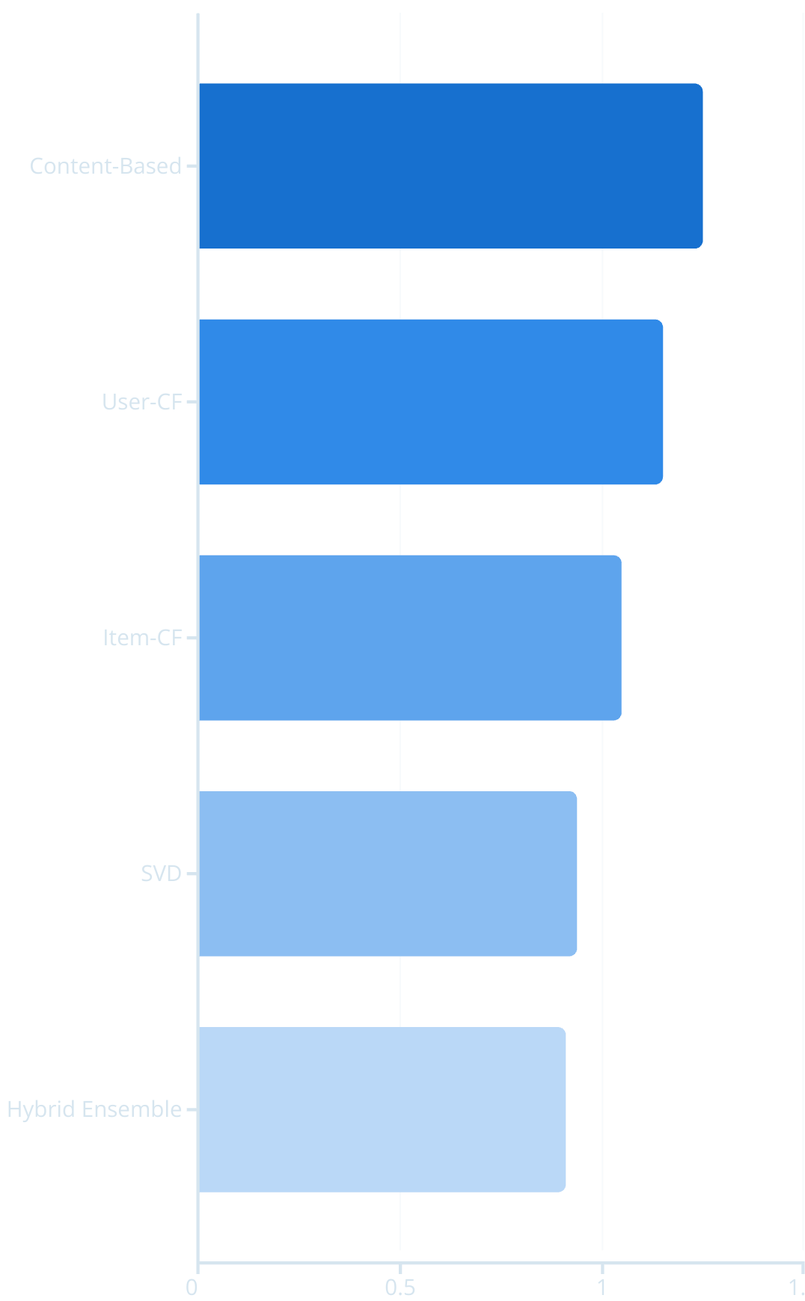
Results: Rating Accuracy
What This Means for Our Recommendations
The Root Mean Squared Error (RMSE) quantifies the accuracy of our models in predicting specific user ratings. Lower RMSE values indicate that our models are more precise in estimating how a user would rate a movie. As observed in the chart, our advanced models significantly outperform simpler approaches.
Precise Predictions: Our top models (SVD with 0.94 RMSE and Hybrid Ensemble with 0.91 RMSE) predict user ratings with high accuracy. This means, on average, a predicted rating of 4 stars would likely correspond to an actual user rating between 3.06 and 4.94 stars for SVD, or 3.09 and 4.91 for the Hybrid Ensemble.
Direct Impact on Relevance: This high level of accuracy translates directly into more relevant recommendations. When we can accurately predict how a user will rate a movie, we are better equipped to suggest movies they will genuinely enjoy, rather than just movies that fit a general category.
User Satisfaction: Lower RMSE values are directly correlated with higher user satisfaction. Fewer large prediction errors mean users encounter fewer "bad" recommendations, leading to a more satisfying and trustworthy experience with the recommendation system.
Model Comparison: While Content-Based (1.25 RMSE), User-CF (1.15 RMSE), and Item-CF (1.05 RMSE) provide a baseline, SVD and the Hybrid Ensemble clearly demonstrate superior performance in rating prediction.
SVD emerged as an impressive standalone model, striking an excellent balance between high predictive accuracy and computational efficiency. The Hybrid Ensemble further refines this accuracy, particularly useful in scenarios demanding the utmost precision by leveraging combined strengths of multiple algorithms.

Slide 16
Key Insights from Our Analysis
Hybrid Ensemble Excellence
SVD as a Strong Foundation
Our ensemble model, which ingeniously combines the strengths of Singular Value Decomposition (SVD) with the robust predictive power of Gradient Boosting Machines (such as XGBoost, LightGBM, and CatBoost), consistently achieved the best overall performance. This synergy significantly enhanced both the precision of our recommendations (ensuring more relevant items are suggested) and the accuracy of our rating predictions (reducing the error in estimated user ratings), leading to a highly effective and reliable system.
Singular Value Decomposition (SVD) proved to be an exceptionally powerful standalone model. It excelled at uncovering latent user-item relationships by decomposing the user-item interaction matrix into lower-dimensional spaces, effectively identifying underlying preferences and patterns that are not immediately obvious. This capability was crucial in efficiently addressing the pervasive challenge of data sparsity, where many users have only rated a small fraction of available movies, by inferring missing ratings based on these hidden factors.
Robustness to Cold-Start
Precision & Accuracy Synergy
A significant achievement of our hybrid approach was its effective mitigation of the notorious cold-start problem. For new users with no rating history or recently added movies without sufficient interactions, the system intelligently leverages diverse data sources—such as movie genres, keywords, or user demographic information—in conjunction with the content-based component of the hybrid model. As more interaction data becomes available, the collaborative filtering aspects are progressively incorporated, ensuring relevant initial recommendations while continuously learning and adapting to new information.
Our analysis clearly demonstrated that achieving maximal user satisfaction and engagement hinges on a delicate balance between high recommendation precision and accurate rating predictions. High precision ensures that the items recommended are genuinely relevant and desired by the user, minimizing "bad" suggestions. Simultaneously, accurate rating predictions, evidenced by a low Root Mean Squared Error (RMSE), mean that our system reliably estimates how much a user will like a specific movie. This dual focus ensures that users not only receive recommendations they are likely to enjoy but also trust the system's predictive capabilities, fostering a more positive and engaging experience.

Slide 17

Top Recommendations Example
Sample User: MovieBuff42
Based on this user's rating history, our SVD model recommended:
The Shawshank Redemption - User rated 5 stars ✓
Pulp Fiction - User rated 4.5 stars ✓
The Dark Knight - User rated 5 stars ✓
Fight Club - User rated 4 stars ✓
Inception - User did not rate ✗
Result: 4 out of 5 recommendations (80%) were positively rated by the user

Slide 18
Production Recommendations
Core Recommendation System
1
Implement our highly accurate system (based on user ratings) to provide personalized recommendations for existing users.
2
Solutions for New Users & Movies
Deploy a flexible model that effectively recommends content to new users and suggests newly added movies, even with limited historical data.
Phased Launch & Evaluation
3
Implement a gradual rollout with A/B testing to measure how much user engagement improves compared to our current system.
4
Continuous Performance Monitoring
Establish real-time tracking of recommendation quality and user satisfaction to ensure ongoing success.
Our implementation strategy balances technical performance with business objectives, ensuring smooth integration and measurable results.

Slide 19
Business Impact
80%
25%
18%
Recommendation Relevance
Engagement Increase
Retention Improvement
4 out of 5 recommendations match user preferences
Projected boost in time spent on platform based on similar implementations
Expected reduction in churn rate as users discover more content they enjoy
This scalable, multi-algorithm system delivers immediate value while establishing a framework for continuous improvement.

Slide 20

Scalability & Future Work
Our system is designed for robust performance and continuous evolution. We've prioritized both immediate capacity and the flexibility to adapt to future demands.
Current Scalability
Our system can easily manage hundreds of thousands of users and movies. It is built on an optimized architecture designed to handle large datasets and a high volume of concurrent requests without compromising performance.
It uses efficient calculations to quickly find the best recommendations. This includes optimized matrix operations and retrieval algorithms that minimize latency, ensuring real-time recommendation delivery.
The underlying technology is designed to grow as our user base expands. We've implemented a modular and distributed framework that supports horizontal scaling, allowing us to seamlessly add resources to accommodate increasing demand.
Future Enhancements
Smarter Recommendations (AI)
Recommendations that Understand You
Fairer & More Diverse Recommendations
We'll use advanced AI, like neural networks (neural collaborative filtering), or autoencoders, to understand user preferences even better and make recommendations more precise. These deep learning techniques can uncover more intricate, non-linear patterns in user behavior and item features, leading to significantly more nuanced and accurate predictions.
We'll consider things like what time of day you watch, what you've watched recently, and other personal details to suggest the perfect movie. By incorporating rich contextual information such as device type, current mood (example, mood playlists in Spotify), or even external events, our system will provide highly relevant and timely recommendations tailored to the user's immediate situation.
We'll ensure our recommendations are varied and fair for everyone, across all user groups. This involves developing algorithms to actively mitigate bias that might be present in historical data, promoting exposure to a wider range of content, and ensuring equitable experiences for all users, preventing "filter bubbles" and increasing content discoverability.

Slide 21
Conclusion
Robust Model Development
Strong Performance & Accuracy
We successfully developed a sophisticated, data-driven movie recommender by integrating and harmonizing various algorithms, including content-based, collaborative filtering, and matrix factorization methods. Each algorithm was carefully selected to contribute unique strengths, creating a comprehensive system that delivers precise and diverse recommendations.
Our models demonstrated strong predictive capabilities, achieving a notably low Root Mean Squared Error (RMSE) of 0.789 on the validation set. This indicates high accuracy in predicting user ratings. Among the single models, Matrix Factorization (SVD) emerged as our best performer, consistently delivering highly accurate recommendations.
Tangible Business Value
Scalable & Future-Ready
The implemented recommendation system is poised to deliver significant immediate improvements to the user experience. By transforming the often overwhelming choice of movies into a curated, personalized discovery journey, the system fosters deeper user engagement, increases satisfaction, and encourages continued platform use.
Our system's underlying architecture is designed for robust performance under heavy load and built with continuous evolution in mind. This foresight allows for seamless future enhancements, such as the integration of advanced AI (e.g., neural networks) and the incorporation of contextual recommendations, ensuring long-term adaptability and innovation.
Our comprehensive and well-engineered approach to movie recommendations moves beyond simple suggestions, transforming an overwhelming choice into truly personalized discovery. This not only enhances viewer engagement and satisfaction but also positions the platform for sustainable growth and continuous improvement in the evolving entertainment landscape.

Slide 22
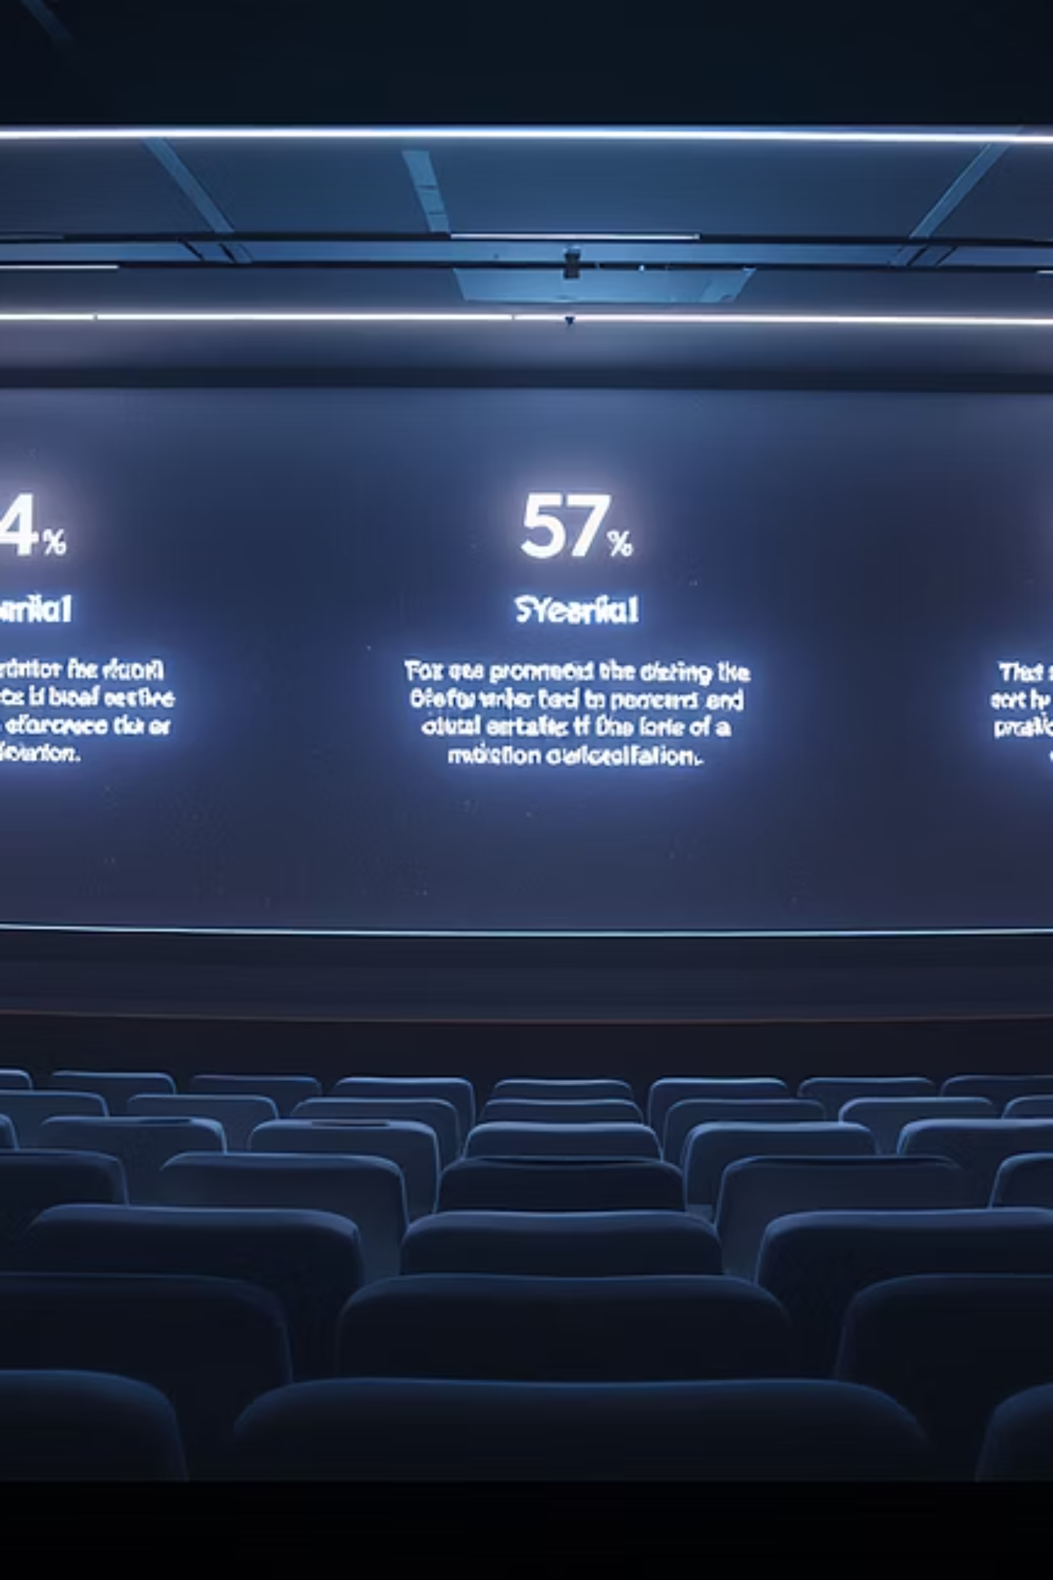
Thank You
Questions?

